Slide 1
COMPUTER system
41100E230 – James Ryan Pregon

Slide 2
CONTENT
Computer Hardware
Operating System

Slide 3
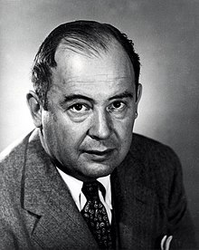
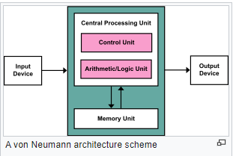
Von Neumann architecture
The von Neumann architecture — also known as the von Neumann model or Princeton architecture — is a computer architecture based on a 1945 description by John von Neumann, and by others, in the First Draft of a Report on the EDVAC.^{[1]} The document describes a design architecture for an electronic digital computer with these components
A processing unit with both an arithmetic logic unit and processor registers
A control unit that includes an instruction register and a program counter
Memory that stores data and instructions
External mass storage
Input and output mechanisms^{[1][2]}

Slide 4
Von Neumann architecture
Design limitations
Von Neumann bottleneck
A shared bus between program and data memory causes the von Neumann bottleneck, the limited throughput (data transfer rate) between the central processing unit (CPU) and memory relative to memory size. Each bus can only access one of the two memory classes at a time, so the throughput is slower than the CPU's operating speed. This severely limits the effective processing speed when the CPU has to do minimal processing of large amounts of data. The CPU has to constantly wait for the data it needs to move in and out of memory. Bottlenecks became a bigger problem as CPU speeds and memory sizes increased much faster than the throughput between them. This problem becomes more serious with each new generation of CPU.

Slide 5
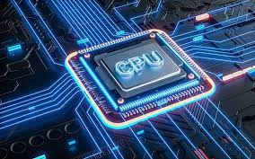
Central processing unit
"CPU" redirects here. For other uses, see CPU (disambiguation).
The central processing unit (CPU), also known as the central processing unit, main processor, or simply processor, is an electronic circuit that executes the instructions that make up a computer program. The CPU performs basic arithmetic, logic, control, and input/output (I/O) operations specified by instructions in your program. This is in contrast to external components such as main memory and I/O circuitry [1], and dedicated processors such as graphics processing units (GPUs).

Slide 6
Central processing unit
The shape, design, and implementation of CPUs have changed over time, but the basic mechanics have remained largely the same. The main components of the CPU include the Arithmetic Logic Unit (ALU), which performs arithmetic and logical operations, the processor registers that supply operands to the ALU and store the results of ALU operations, and the control unit that handles fetches. will be memory) orchestration. Decode and execute (instructions) by directing the coordinated operation of ALUs, registers, and other components.

Slide 7
Processor register
Processor registers are quick-access storage locations available to a computer's processor. [1] Registers typically consist of small amounts of fast memory, but some registers have special hardware features and may be read-only or write-protected. In computer architecture, registers are usually addressed by mechanisms other than main memory, but in some cases they can be assigned memory addresses. December PDP-10, ICT 1900.[

Slide 8
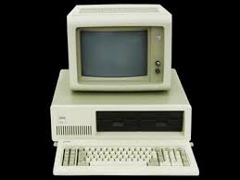
PC stands for Program Counter
The Program Counter (PC) is often called the Instruction Pointer (IP), and on Intel x86 and Itanium microprocessors, the Instruction Address Register (IAR) Instruction Counter or part of it is. The instruction sequencer is a processor register that indicates where the computer is in program flow.
Normally, after an instruction is fetched, the PC is incremented to hold the memory address ("point") of the next instruction to be executed.
Normally the processor fetches instructions from memory in order, but control transfer instructions change the order by putting new values ​​into the PC. This includes branches (sometimes called jumps), subprogram calls, and returns. In transfers that depend on the truth of statements, computers follow different sequences under different conditions.

Slide 9
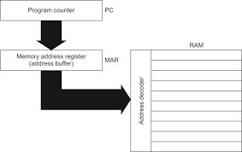
Memory address register
In computers, the Memory Address Register (MAR is a CPU register that stores either the memory address where data is fetched into a CPU register, or the address where data is sent and stored across the system bus.
In other words, this register is used to access data and instructions from memory during the instruction execution phase. A MAR contains the location of the data you need to access. When reading from memory, the data addressed by MAR is fed to the MDR (Memory Data Register) for use by the CPU. When writing to memory, the CPU writes data from MDR to the memory location whose address is stored in MAR. The MAR, which resides on the CPU, moves to either RAM (random access memory) or cache.
The MAR register is half of the minimal interface between microcode and computer memory. The other half is MDR.

Slide 10
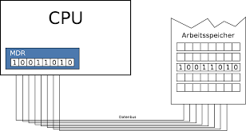
Memory buffer register
A memory buffer register (MBR) or memory data register (MDR) is a register in a computer's CPU that stores data transferred to and from random access memory. It contains a copy of the value at the location specified in the memory address register. It acts as a buffer, allowing the processor and memory units to operate independently without being affected by minor operational differences. If the data item is available for the processor to read or write, or if it can be stored in main memory after writing, it is copied into the MBR ready for use on the next clock cycle.

Slide 11
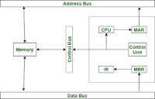
Instruction register
In computing, the Instruction Register (IR) or Current Instruction Register (CIR) is the part of the CPU's control unit that contains the instruction being executed or decoded. In simple processors, each instruction to be executed is decoded, prepared, and finally loaded into the instruction register containing it when it is executed. This may require several steps.

